Slide 1
Python
Presentation
Mai Tat Chuyen

Slide 2
Team K66
Nguyễn Nhật Nguyên Dương
Trịnh Khánh Ly
Đặng Thanh Huyền
Ong Thị Huyền Trang
Mai Tất Chuyên

Slide 3


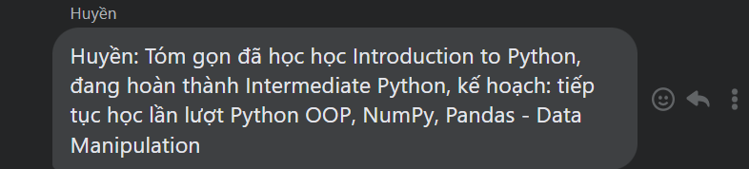
Team K66

Slide 4







Mai Tất Chuyên
CTTT Y sinh 01-k66
Định hướng : xử lí ảnh y tế
Come from : Thanh hóa
Skills : Làm slide, lập trình python, cầu lông
Chuyen.mt213657@sis.hust.edu.vn
0325510961

Slide 5
Một số kiến thức đã biết :
Python cơ bản
Numpy
Pandas and visualization with Pandas

Slide 6
The Need for Machine Learning Design Patterns
1. Machine Learning Terminology
2. Common Challenges in Machine Learning

Slide 7
Chapter 1 : The need for ML design patterns
I,Machine learning termilogy
1, Model and Framework
Machine learning is a process of building models that learn from data
Machine learning models are algorithms that learn patterns from data
Feed-forward neural are a type of ML algorithm whereby multiple layers, each with many neurons
Input
Analyze
Process
Output

Slide 8
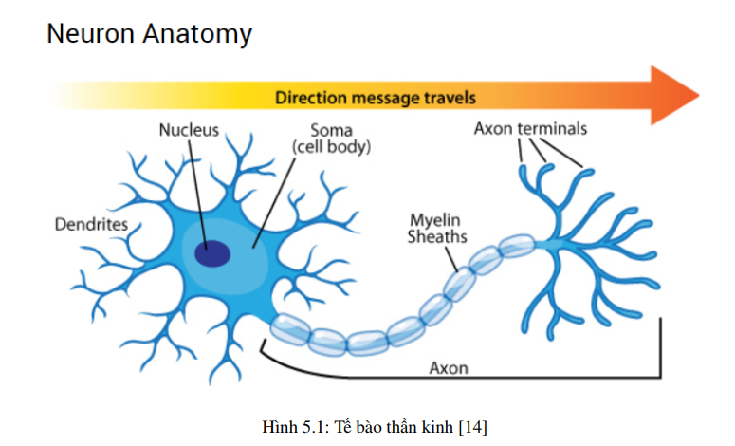
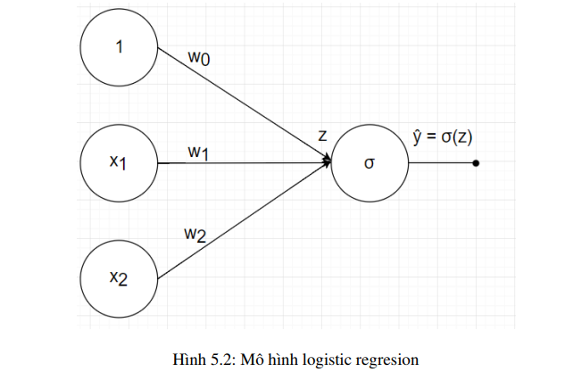
Neural Network : Input layer – hidden layer – outpput layer

Slide 9
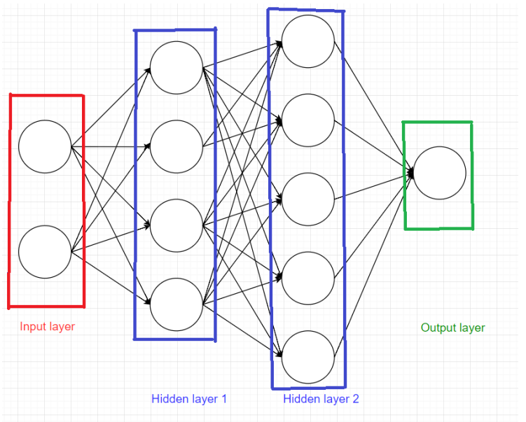
NN with more than one hidden layer are classified as deep learning
Each hidden layer is called fully connected layer, each node in hidden layer are connected with all node in previous layer . All model is called fully connected neural network (FCN)

Slide 10
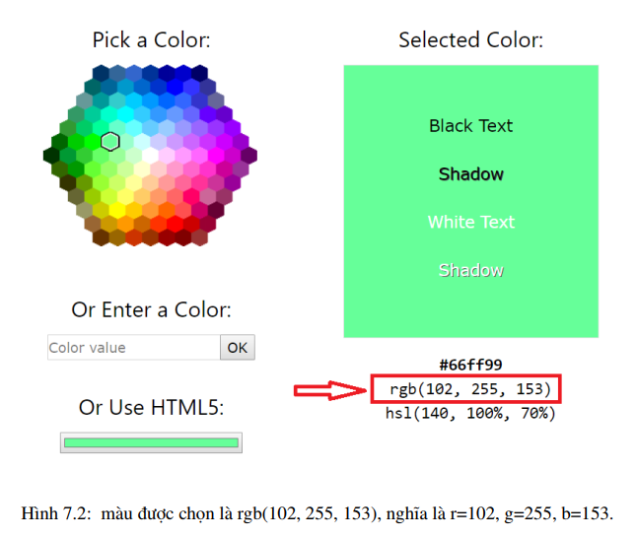
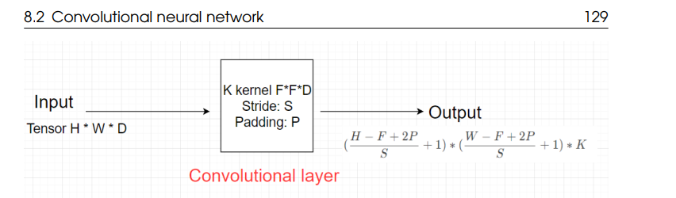
Convolutional
neural network

Slide 11
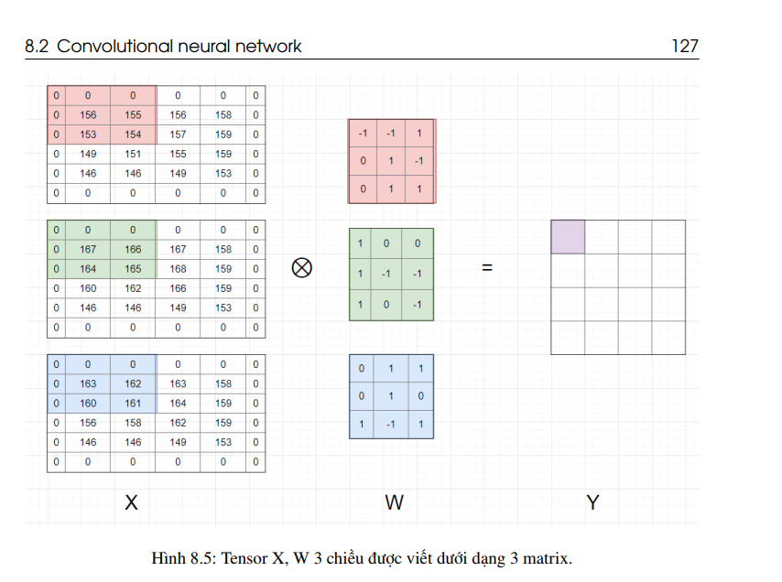

Slide 12
NN with only an input and output layer are another subset of machine learning known as linear models
It represent the patterns which learned from data using linear function

Slide 13

Libraries
TensorFlow library- an open source ML framework created by Google with a focus on DL models
Keras – a API which supports many backends
Some other : Scikit-learn, XGBoost, and PyTorch

Slide 14
Grouping by learning method
Classify and label
objects on images
Classification
Supervised learning
Continous
Ex : predict the house’s
price
Regression
ML
Linear regression
Logictics regression
Unsupervised learning

Slide 15
Grouping by learning method
Supervised learning
ML
Goupings of your data (called clustering)
Compress the information content (dimensionality reduction)
Unsupervised learning
Find association rules

Slide 16
2. Data and Feature engineering
Data is the heart of any ML problem
Training data: the data fed to your model during the training process
Validation data: held out from your training set + used to evaluate how the model is performing after each training epoch
used to decide when to stop the training run, and to choose
hyperparameters
Test data: not used in the training process at all
used to evaluate how the trained model performs

Slide 17
Numerical
(int, float)
Structured Data
Categorical : can be divided in to a
finite sset of groups

Slide 18
3. Machine learning process
Training— passing training data to a model so that it can
learn to identify patterns
Evaluation — testing how the model performs on data outside
of your training set
Prediction — sending new data to the model and making use
of its output

Slide 19
4.Roles
A data scientist
A data engineer
Machine learning engineers
Research scientists
Data analysts
Developers

Slide 20
II. Common challenges in Machine learning
1. Data quality
- Accuracy
- Completeness
- Consistency
- Timeliness
2. Reproducibility

Slide 21
3. Data Drift
Data can change significantly over time
Continually update your training dataset
Retrain your model
Modify the weight your model
How to fix

Slide 22
Timeline
ML design patterns
--ML design patterns--
?
1
3
5
2
4
6
GAN
Computer vision
Paper

Slide 23
Thank you so much for listening

